Slide 1
Intel E2E Setup

Slide 2

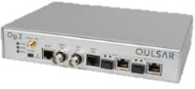
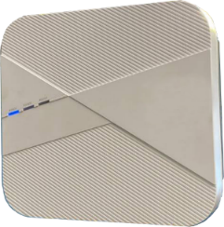
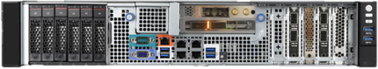

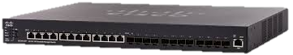
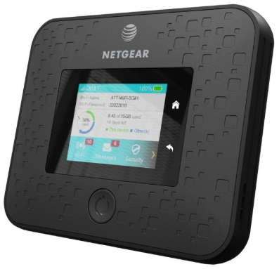

Intel E2E Topology
G.M
Foxconn need
WNC (X)
RJ45
2
1
5GC
RJ45
3
10G/SFP+
USB
Fiber
5gc Switch
L1+DU+CU
10G/SFP+
enp61s0f0
FIber enp61s0f1
Dell Switch
USB
4
USB3.1
Remote Control
Example ASRock 11

Slide 3
Intel E2E Topology
3
L1+DU+CU
2
1
5GC
10G/SFP+(vlan 1111)
enp61s0f0(vlan 1111)
enp134s0f1
Fiber
10G/SFP+
5gc Switch
4
Dell Switch
USB3.1
Example ASRock 12
Remote Control

Slide 4
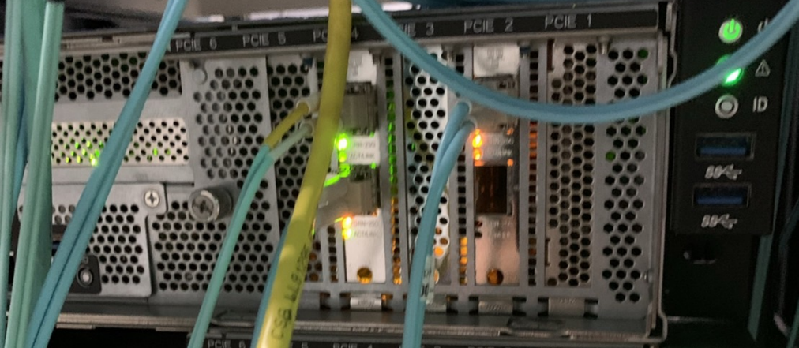
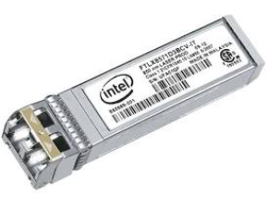
Prepare for GNB server
Asrock#11
Intel Mount Bryce
a
c
b
Example:
Port a: Connnect to DELL switch setup for serving RU connect / IEEE 1588 TimeSync
Port b: Connnect to 5gc switch setup for serving affirmed 5gc
Port c: QAT for CU using HW CRYPTO
Intel Mount Bryce for Flexran init
Before setup you need to prepare
1. Intel E10GSFPSR or 25G at least x4
2. Fiber Cable at least x2
3. QAT Card (check server) x1
4. Mount Bryce (check server) x1
You could register and brrow these item with Tina
!請確定各光孔的連接目的

Slide 5
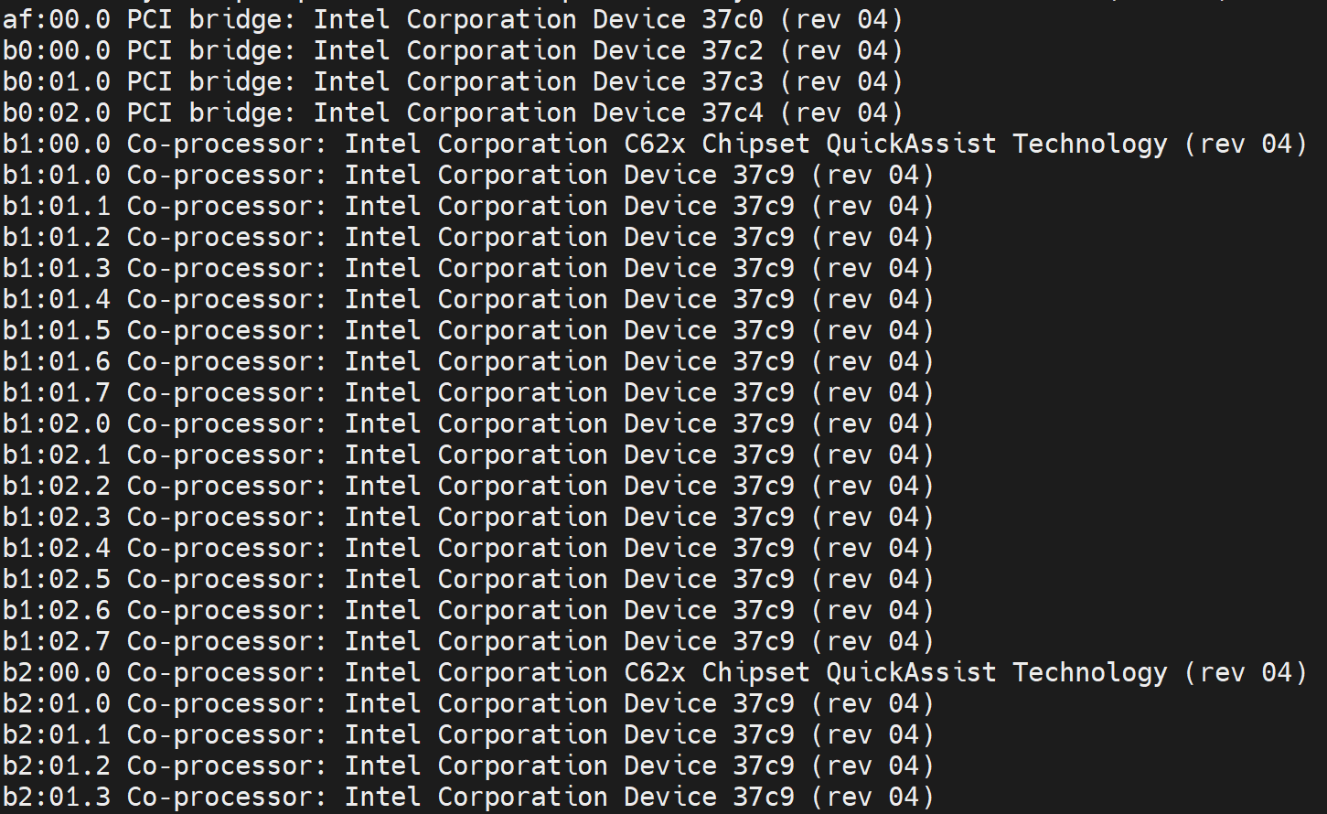
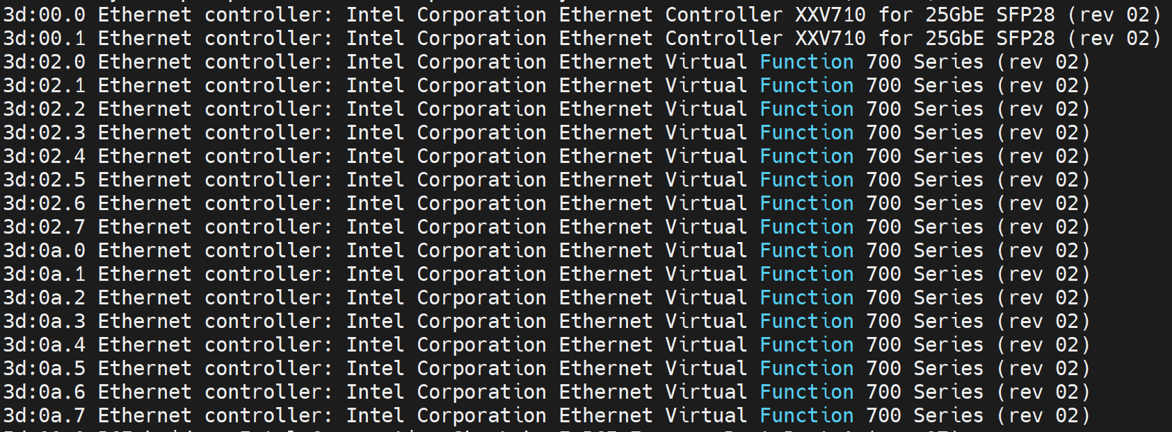
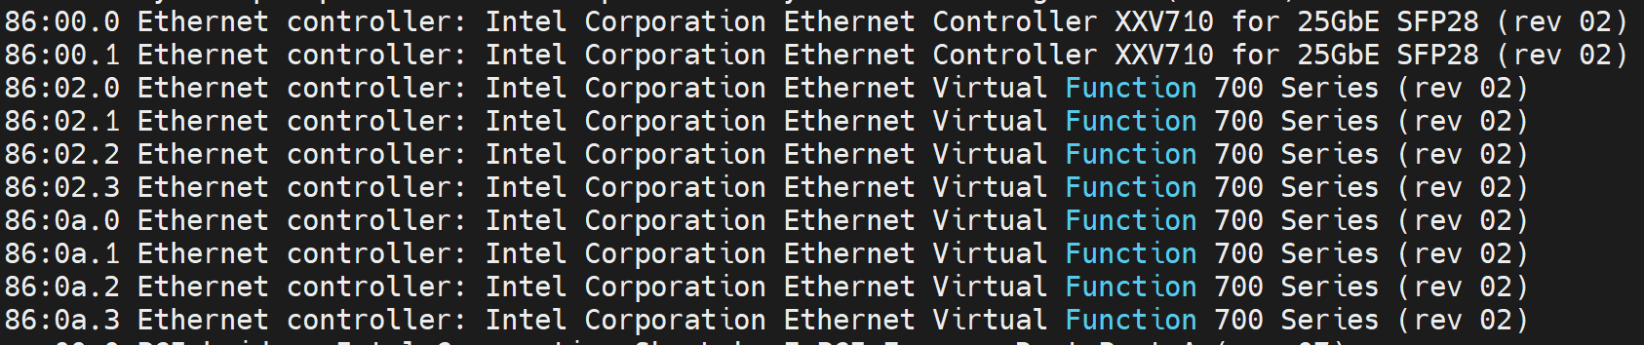
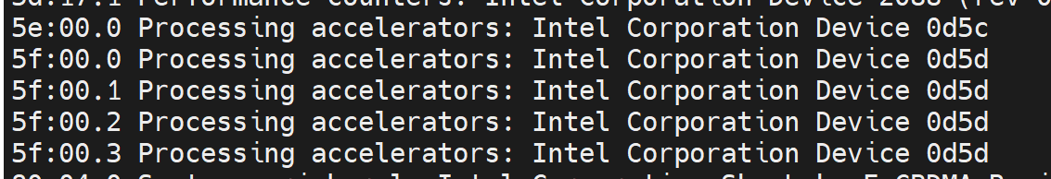
Checking for Asrock PCI bus device
Asrock
Checking for Asrock PCI bus device
[root@5gran-asrock-11 docker-gnb]#
lspci
Intel Mount Bryce
a
c
b
Port a: Connnect to DELL switch setup for serving RU connect
/ IEEE 1588 TimeSync
Port c: QAT for CU using HW CRYPTO
Port b: Connnect to 5gc switch setup for serving free5gc
Intel Mount Bryce for Flexran init

Slide 6
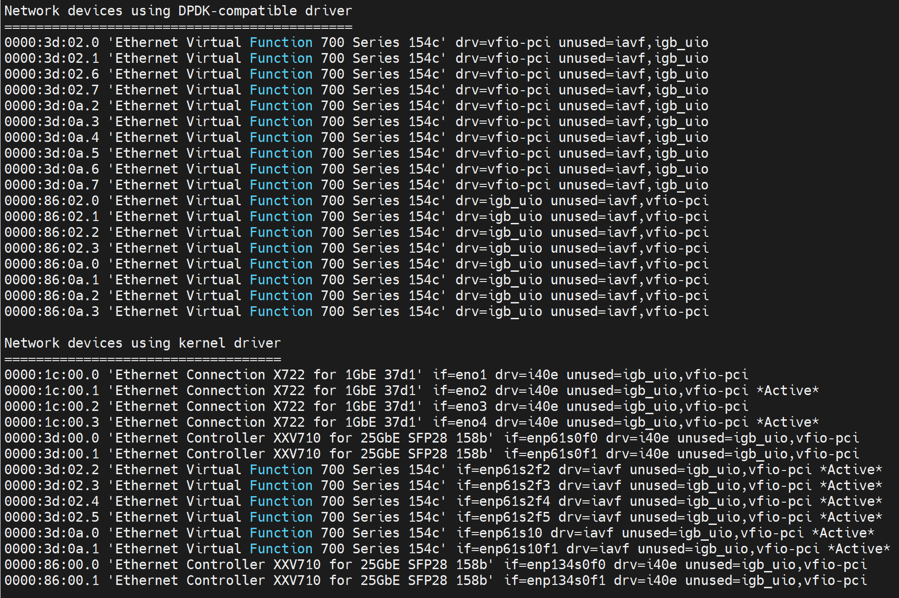
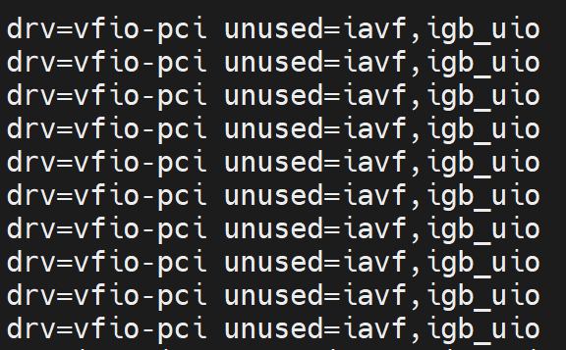
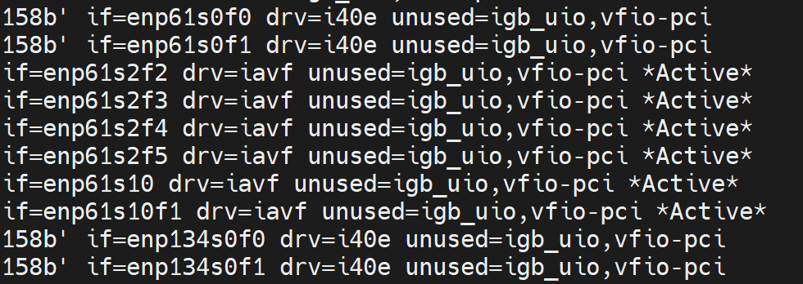
Checking for Asrock PCI Device Driver
Asrock
Intel Mount Bryce
a
Checking for Asrock PCI Device Driver
[root@5gran-asrock-11 docker-gnb]#
dpdk-devbind -s
c
b

Slide 7
GNB Env Setup
Asrock
Intel Mount Bryce
a
c
b
Should following gnbctl to setup
./gnbctl profile set radisys251_affirmed5gc ./gnbctl sriov init
./gnbctl cu init
./gnbctl du init
./gnbctl flexran init
for example
#enp61s0f0 #Port a
echo 0 > /sys/bus/pci/devices/0000\:3d\:00.0/sriov_numvfs
echo 8 > /sys/bus/pci/devices/0000\:3d\:00.0/sriov_numvfs
ip link set dev enp61s0f0 vf 0 mac 00:11:34:86:0a:00 state enable vlan 1111
ip link set dev enp61s0f0 vf 1 mac 00:11:34:86:0a:01 state enable vlan 1111
ip link set dev enp61s0f0 vf 2 mac 00:11:33:3d:02:03 state enable
ip link set dev enp61s0f0 vf 3 mac 00:11:33:3d:02:04 state enable
ip link set dev enp61s0f0 vf 4 mac 00:11:33:3d:02:05 state enable
ip link set dev enp61s0f0 vf 5 mac 00:11:33:3d:02:06 state enable
#enp61s0f1 #Port b
echo 0 > /sys/bus/pci/devices/0000\:3d\:00.1/sriov_numvfs
echo 8 > /sys/bus/pci/devices/0000\:3d\:00.1/sriov_numvfs
ip link set dev enp61s0f1 vf 0 mac 00:11:99:3d:0e:0 state enable
ip link set dev enp61s0f1 vf 1 mac 00:11:99:3d:0e:1 state enable
ip link set dev enp61s0f1 vf 2 mac 00:11:99:3d:0e:2 state enable
ip link set dev enp61s0f1 vf 3 mac 00:11:99:3d:0e:3 state enable
ip link set dev enp61s0f1 vf 4 mac 00:11:99:3d:0e:4 state enable
ip link set dev enp61s0f1 vf 5 mac 00:11:99:3d:0e:5 state enable
!光孔不同目的配合不同設置
連接 RU的MAC 需與WNC寫入的MAC相符

Slide 8
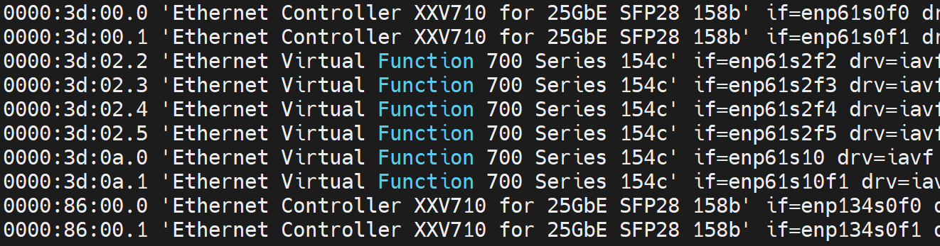
dpdk-devbind and ifconfig
Asrock
For Example
Intel Mount Bryce
a
#3d port1 #RU
dpdk-devbind -b vfio-pci 3d:02.{0,1}
dpdk-devbind -b iavf 3d:02.{2,3,4,5}
#3d port2 #5gc
dpdk-devbind -b iavf 3d:0a.{0,1}
dpdk-devbind -b igb_uio 3d:0a.{2,3,4,5}
#MountBryceCard using on docker-flexran5g.env
dpdk-devbind -b vfio-pci 5f:00.2
c
b
Match with docker-gnb.env and CU/DU oam_config
ifconfig enp61s2f3 192.168.50.133 netmask 255.255.255.0 up
ifconfig enp61s2f5 192.168.50.135 netmask 255.255.255.0 up
ifconfig enp61s10f1 192.168.120.92 netmask 255.255.255.0 up
ifconfig enp61s2f2 4.4.4.33 netmask 255.255.255.0 up
ifconfig enp61s2f4 4.4.4.35 netmask 255.255.255.0 up
ifconfig enp61s10 5.5.5.92 netmask 255.255.255.0 up

Slide 9
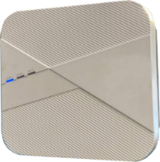
Docker GNB_0.1.0.7 Topology #Asrock11
gNB DU
gNB CU
DU_F1C
CU_F1C
enp134s2f2
192.168.10.103
192.168.10.102
enp61s6f2
DU_F1U
CU_F1U
4.4.4.102
enp61s6f1
SCTP
enp134s2f1
4.4.4.103
enp134s10f1
172.16.30.118
enp134s10f2
172.16.29.118
RU0
gNB Flexran
enp61s0f0
RU0_FHU/FHC
CU_NGU
CU_NGC
UE
Affirmed
172.16.30.1 172.16.29.1
M5
NGU 172.16.20.14
NGC
172.16.17.226
MiFi
iperf3
172.16.26.123
172.16.26.125

Slide 10
Docker GNB_0.1.0.7 Topology #Asrock12
gNB DU
gNB CU
DU_F1C
CU_F1C
enp134s2f2
192.168.10.17
192.168.10.65
enp61s6f2
DU_F1U
CU_F1U
4.4.4.65
enp61s6f1
SCTP
enp134s2f1
4.4.4.17
enp134s10f1
172.16.30.110
enp134s10f2
172.16.29.110
RU0
gNB Flexran
enp61s0f0
RU0_FHU/FHC
CU_NGU
CU_NGC
UE
Affirmed
172.16.30.1 172.16.29.1
M5
NGU 172.16.20.14
NGC
172.16.17.226
MiFi
iperf3
172.16.26.123
172.16.26.125

Slide 11
Docker GNB_0.0.7 Topology #Asrock11
gNB DU
gNB CU
DU_F1C
CU_F1C
enp61s2f5
192.168.50.105
192.168.50.100
enp61s2f3
DU_F1U
CU_F1U
4.4.4.3
enp61s2f2
SCTP
enp61s2f4
4.4.4.5
enp61s10
5.5.5.72
enp61s10f1
192.168.120.72
RU0
gNB Flexran
enp61s0f0
RU0_FHU/FHC
CU_NGU
CU_NGC
GTP-U / N3
UE
free5gc
AMF:N2 192.168.120.101
SMF:N4 192.168.104.33
5.5.5.101
M5
UPF:N6 192.168.105.132
MiFi
VS
iperf3
192.168.105.201

Slide 12
Docker GNB_0.1.0 Topology #Asrock12
gNB DU
gNB CU
enp61s10f3
DU_F1C
CU_F1C
enp134s2f2
192.168.10.65
192.168.10.107
enp61s10f2
DU_F1U
SCTP
CU_F1U
enp134s2f1
4.4.4.65
4.4.4.17
enp134s10f1
172.16.30.107
enp134s10f2
172.16.29.107
enp61s14
enp61s14f1
gNB Flexran
enp61s0f0
RU0
5.5.5.107
192.168.120.107
RU0_FHU/FHC
CU_NGU
CU_NGC
CU_NGU
CU_NGC
UE
AMF:N2 192.168.120.202
SMF:N4 192.168.104.134
172.16.29.1 172.16.30.1
M5
UPF:N6 192.168.105.233
5.5.5.203
NGU
172.16.20.14
NGC
172.16.17.226
VS
iperf3
192.168.105.201
MiFi
free5gc
IPERF3
172.16.26.123
Affirmed

Slide 13
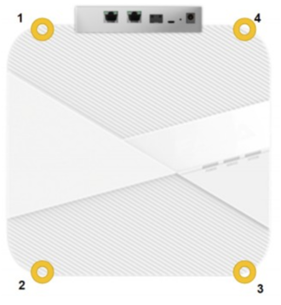
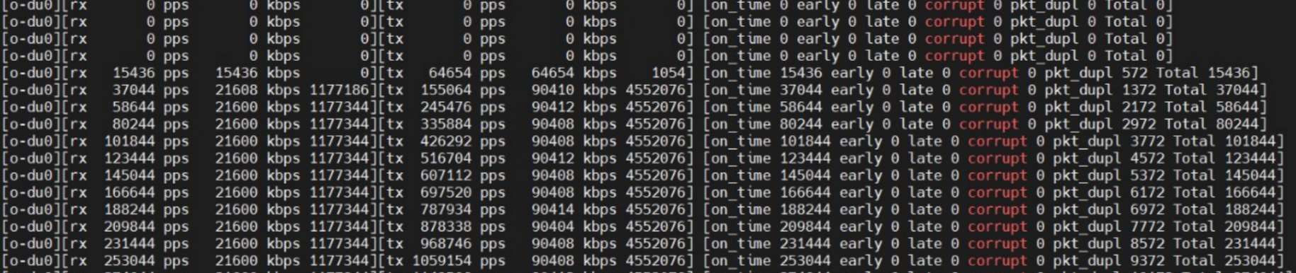
RU Init & O-du test
Asrock #12
RU Init (Foxconn)
Power on RU, check console status
./set_port.sh 0
./init_rrh_config_enable_cuplane (wait for 10 min)
O-du test check
cd /home ; ./odu_test.sh
GNB PTP Check
cd /home ; ./do_ptp.sh

Slide 14
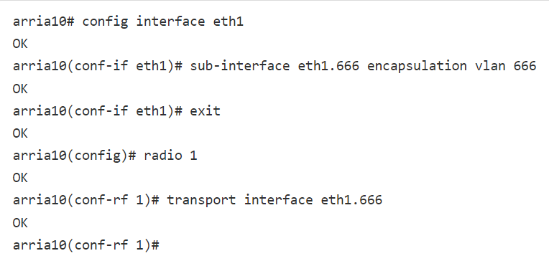
RU Init
Asrock #12
RU Init (WNC)
show ptp clock(wait the ptp lock)
radio enable
RU vlan setting
GNB PTP Check
tail -f /var/log/message

Slide 15
WNC RU INIT setting
RU Init (WNC)
#n78 power command
fpga write 0xff220008 0x08000001
radio debug radioctrlcfg-set 0 0 0xf
radio debug radioctrlcfg-set 1 0 0xf
radio debug pa-set 0x0
radio debug paprot 2200
radio debug pa-set 0x1
radio debug rxtx-en 0x1 0x0
radio debug pa-set 0x0
radio debug rxtx-en 0x0 0x0
radio debug radioctrlcfg-set 0 1 0x1
radio debug radioctrlcfg-set 0 1 0x2
radio debug radioctrlcfg-set 0 1 0x4
radio debug radioctrlcfg-set 0 1 0x8
radio debug radioctrlcfg-set 1 1 0x1
radio debug radioctrlcfg-set 1 1 0x2
radio debug radioctrlcfg-set 1 1 0x4
radio debug radioctrlcfg-set 1 1 0x8
fpga write 0xff220008 0x0
radio debug lna-set 0 0xf
#n79 power command
fpga write 0xff220008 0x08000001
radio debug radioctrlcfg-set 0 0 0xf
radio debug radioctrlcfg-set 1 0 0xf
radio debug pa-set 0x0
radio debug paprot 1900
radio debug pa-set 0x1
radio debug rxtx-en 0x1 0x0
radio debug pa-set 0x0
radio debug rxtx-en 0x0 0x0
radio debug radioctrlcfg-set 0 1 0x1
radio debug radioctrlcfg-set 0 1 0x2
radio debug radioctrlcfg-set 0 1 0x4
radio debug radioctrlcfg-set 0 1 0x8
radio debug radioctrlcfg-set 1 1 0x1
radio debug radioctrlcfg-set 1 1 0x2
radio debug radioctrlcfg-set 1 1 0x4
radio debug radioctrlcfg-set 1 1 0x8
fpga write 0xff220008 0x0
radio debug lna-set 0 0xf
Login id/pwd : root/(null)
enable
# setup mac of RU
config interface eth1
shutdown
mac-address 00:aa:ff:bb:aa:34
no shutdown
exit
exit
# setup mac of DU 00:11:34:86:0a:00
fpga write 0xff25008c 0x34860a00
fpga write 0xff250090 0x00000011
radio enable

Slide 16
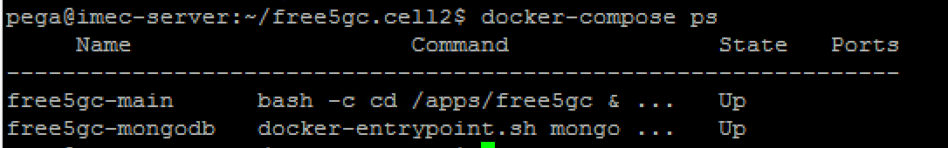
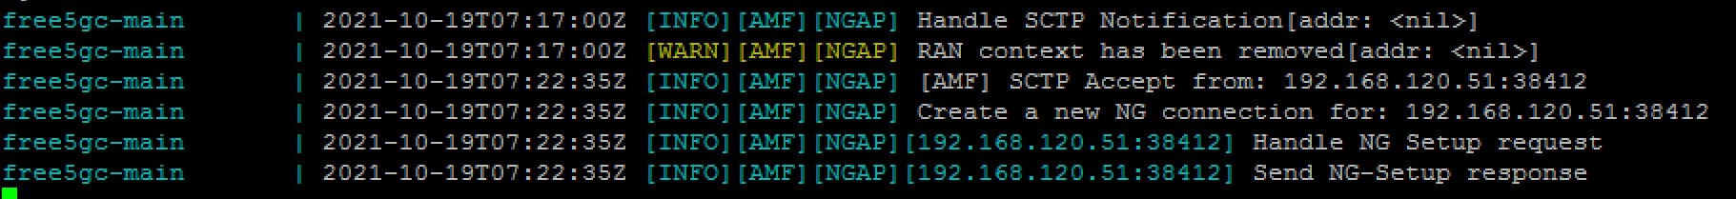
Free5gc Init
ssh pega@10.255.174.18 (password: pega#1234)
cd free5gc.cell2/
docker-compose ps
docker-compose down
docker-compose up -d
./show-log.sh
UPF Restart
dokcker-compose down
./imec-upf-restart.sh
docker-co mpose up

Slide 17
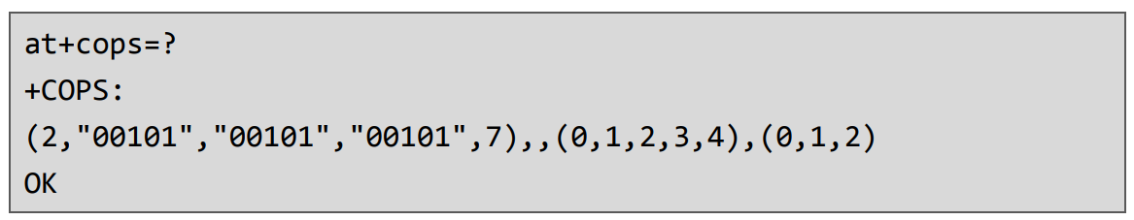
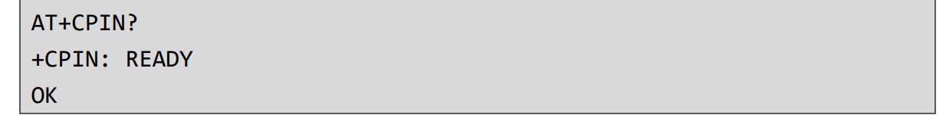
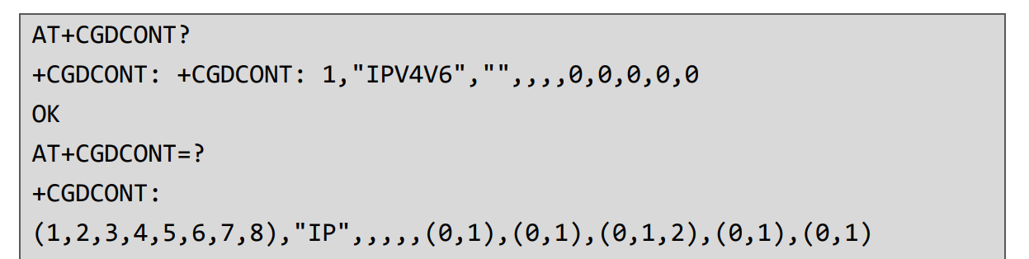
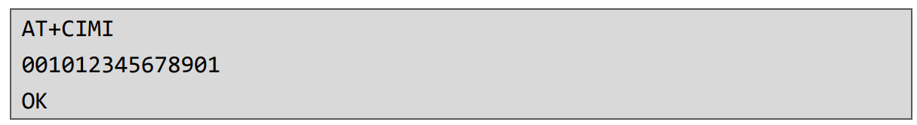
UE Control (at command)
### Search Network Operation###
at_cmd.sh at+cops=?
### Network registration status###
at_cmd.sh at+cops?
at_cmd.sh at+cops=1,2,”00101”
### Check APN/DNN Setting###
at_cmd.sh at+cgdcont?
### Set APN/DNN Setting###
at_cmd.sh at+cgdcont=1,”IP”,”PEGAPN-LD3”
ATE0 (not display)
ATE1 (display)
ATI (Product Identification)
AT+CFUN=0 (Minimum function)
AT+CFUN=1 (Full function)
### check sim status ###
AT+CPIN?
### GET IMSI ### AT+CIMI
### GET IMEI ### AT+GSN
### GET CESQ ### AT+CESQ

Slide 18
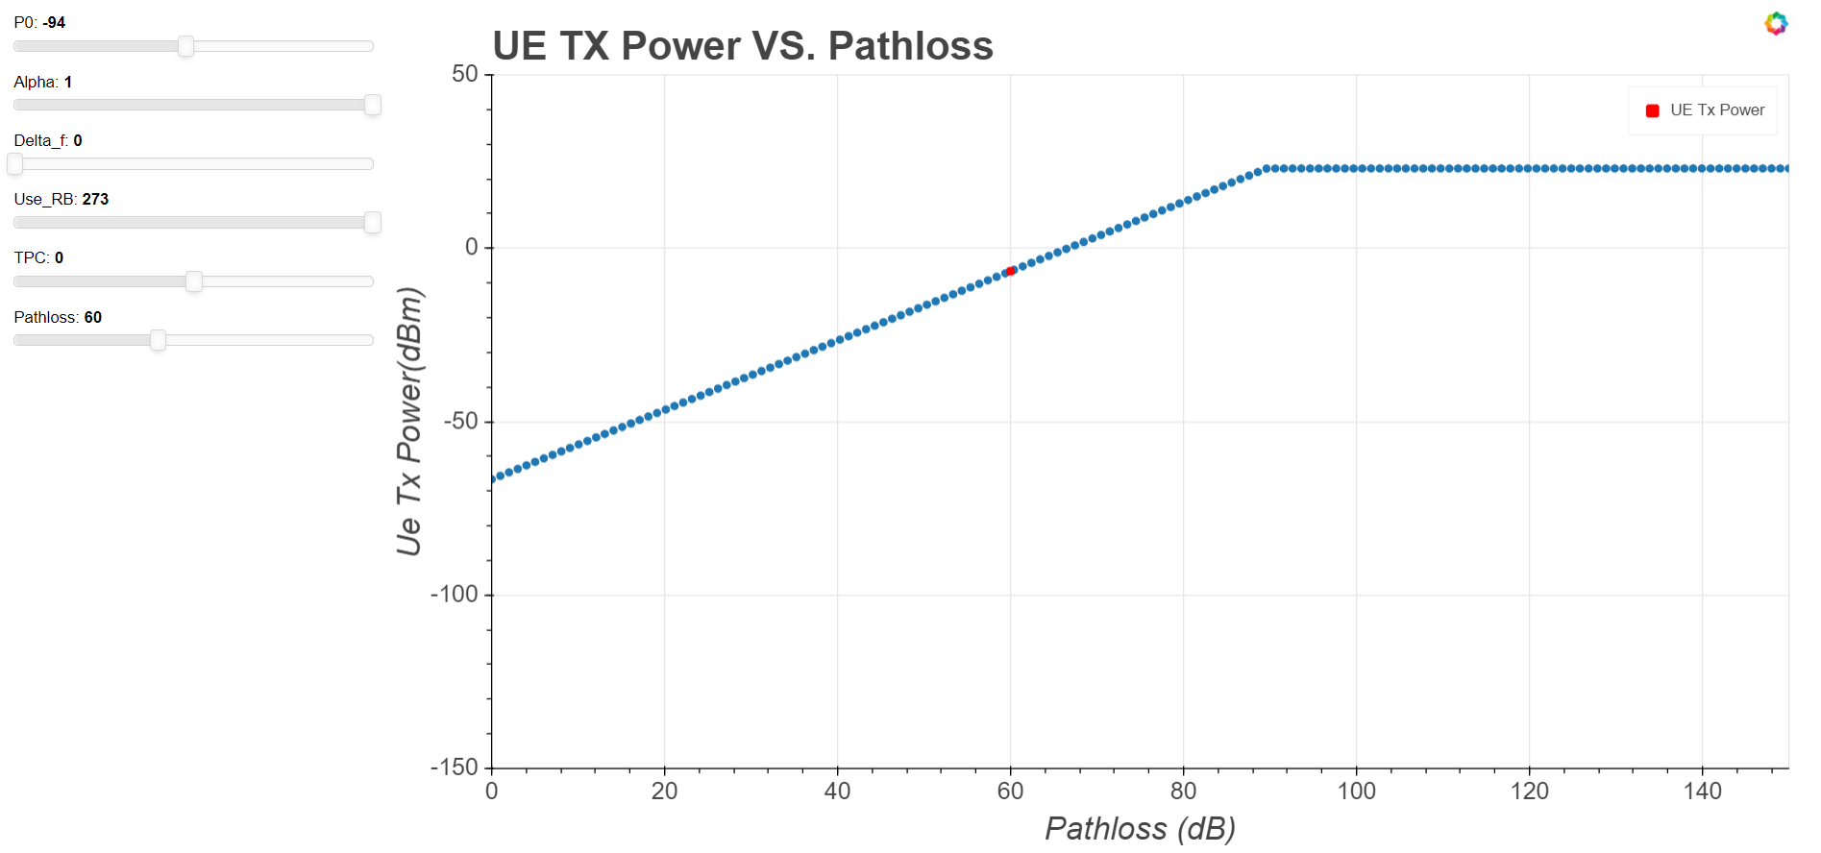
Initial power tuning tool - by Fangming
Theoretical value through open loop power control turning tool:

Slide 19
Bring-up sanity test - QXDM logging check
Item | Key | QXDM filter
Registration procedure (RRC/NAS) | - | Log Packets(OTA)/NR5G/NAS Log Packets(OTA)/NR5G/RRC
L1, L2 Analyze | 0076/04 | QTraces/COMMON/QSH/ANALYSIS
MAC layer information (ex. RACH, DCI info, PDSCH status, ...) | - | Log Packets/NR5G/MAC
TX Power | 0XB8D2 | Log Packets/LL1/FW/NR5G LL1 FW MAC TX IU power
RSSI | 0xB8C9 | Log Packets/LL1/FW/NR5G LL1 FW RX Control AGC
RSRP/RSRQ | 0xB97F | Log Packets/ML1/NR5G ML1 Searcher Measurement Database Update Ext
SINR | 0042/00 | QTraces/MMCP/MMODE/

Slide 20
AsRock#11 init
Run PTP
cd /home/wnc
./do_ptp.sh
tail -f /var/log/message
掛載vfio-pci
sudo modprobe vfio-pci
docker init
cd /home/wnc/docker-gnb_0.1.0.7/docker-gnb
./gnbctl sriov init
./gnbctl flexran init
./gnbctl du init
./gnbctl cu init
Check the NG connect
ping 172.16.29.1; 172.16.30.1; 172.16.20.1; 172.16.17.1

Slide 21
AsRock#12 init
Run PTP
cd /data2
./setup_ota_e2e ptp_old
tail -f /var/log/message ; tail -f /var/log/phc2sys
docker init
cd /data2/wnc/docker-gnb_0.1.0/docker-gnb
./gnbctl sriov init
./gnbctl flexran init
./gnbctl du init
./gnbctl cu init
Check the NG connect
ping 172.16.29.1; 172.16.30.1; 172.16.20.1; 172.16.17.1

Slide 22
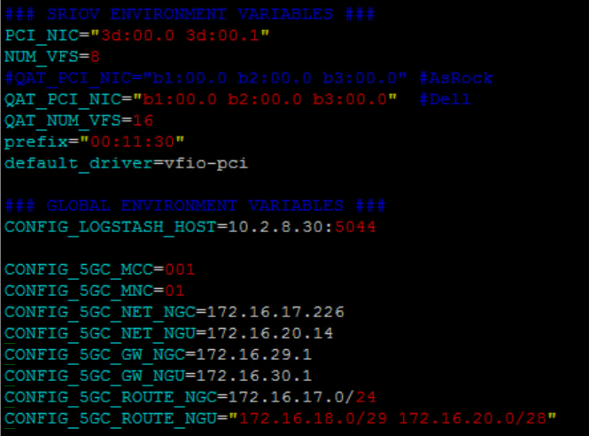
Docker 0.1.0.7 env setup
Git docker-gnb project
git clone ssh://git@172.18.220.81:10022/5g-o-ran/gnodeb/docker-gnb.git
設定profile
cd docker-gnb/
./gnbctl profile clear
./gnbctl profile set radisys251_affirmed5gc
PCI、QAT、MCC、MNC設定(docker-gnb.env)
cd profile/active/
vim docker-gnb.env
設定QAT PCI
設定NGU/NGC

Slide 23
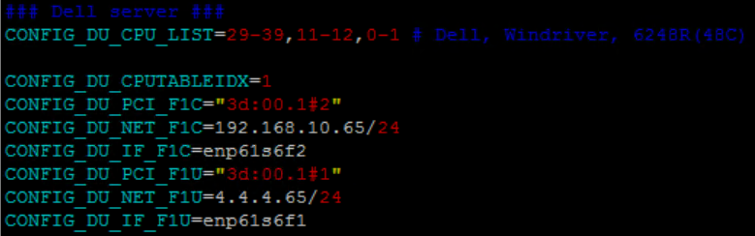
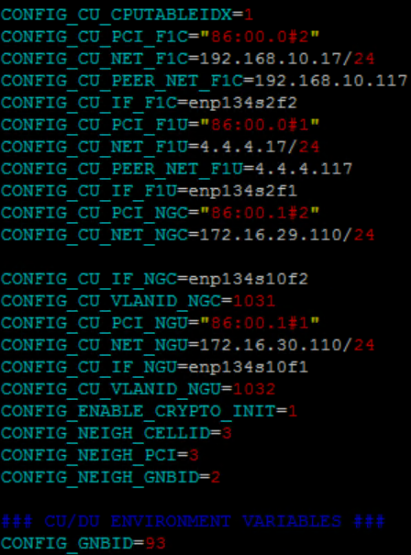
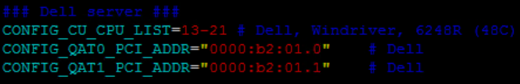
Docker 0.1.0.7 env setup
DU Setting(CPU、ip)
CU Setting(QAT、network card、vlan)
CU F1C/F1U ip setting
F1C/F1U ip setting
CU NgC/NgU ip setting

Slide 24
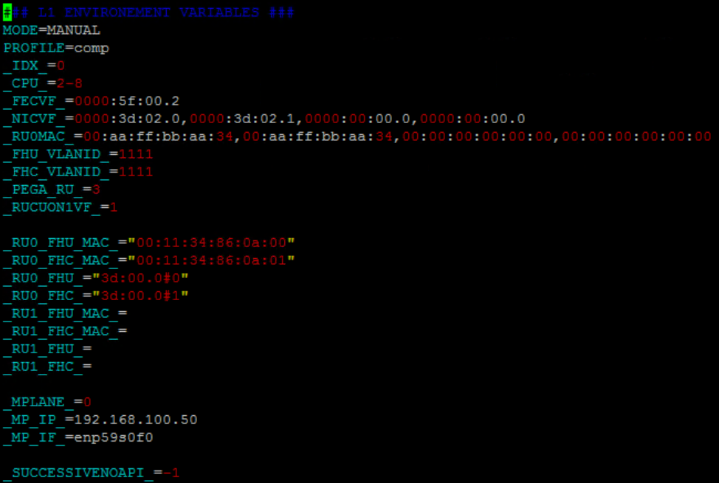
Docker 0.1.0.7 env setup
RU 、 DU MAC 、 vlan setting(docker-flexran.env)
DU and RU mac setting

Slide 25
Iperf 指令
iperf server(172.16.26.123)
位置在Demo room地上主機
cd /home/pega
./kill_iperf3_servers_FM.sh
./iperf3_BG_FM.sh
iperf server(172.16.26.125)
ssh pega@10.255.174.121(passoword: Pega#1234)
iperf3 -s -p 40000(40000~49999皆可使用)
iperf throughput
iperf3 -c (.123 or .125) -p (40000~49999) -t (時間) -w (window size) -l (len) -u(有為UDP,沒有為TCP) -b (頻寬) -R(有為downlink,沒有為uplink)
example: iperf3 -c 172.16.26.125 -p 40000 -t 120 -w 410K -l 1300 -u -b 600m -R

Slide 26
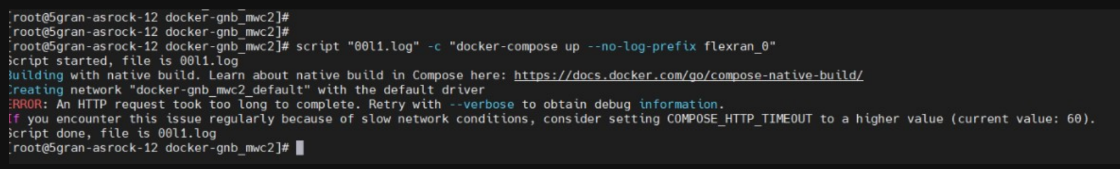
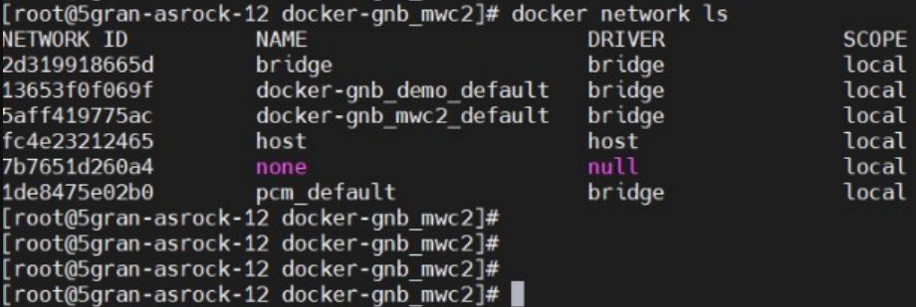
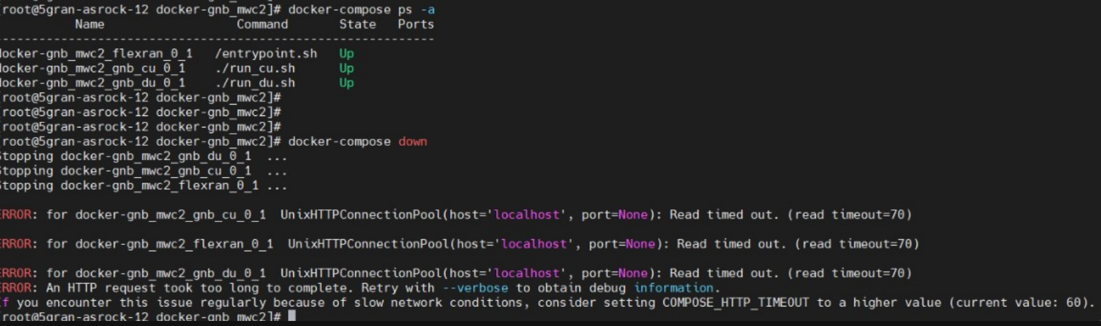
Docker container Problem
解決方式:
1. 檢查, docker-compose ps -a
2. 將目前執行之docker container 停掉, docker-compose down
3. 檢查, docker network ls
4. docker network rm NETWORK_ID
5. sudo systemctl restart docker

